Slide 1


Project Stakeholders Presentation: Projects Resource Allocation
Target Stakeholder Group: Program Leaders

Slide 2

Key Insights
Projects D and E have saved costs that can be freed to balance the ballooning costs of Project C.
Project C is well behind schedule and at risk for failure
Recommendation: Divert excess resources to Project C to get it back on track.

Slide 3
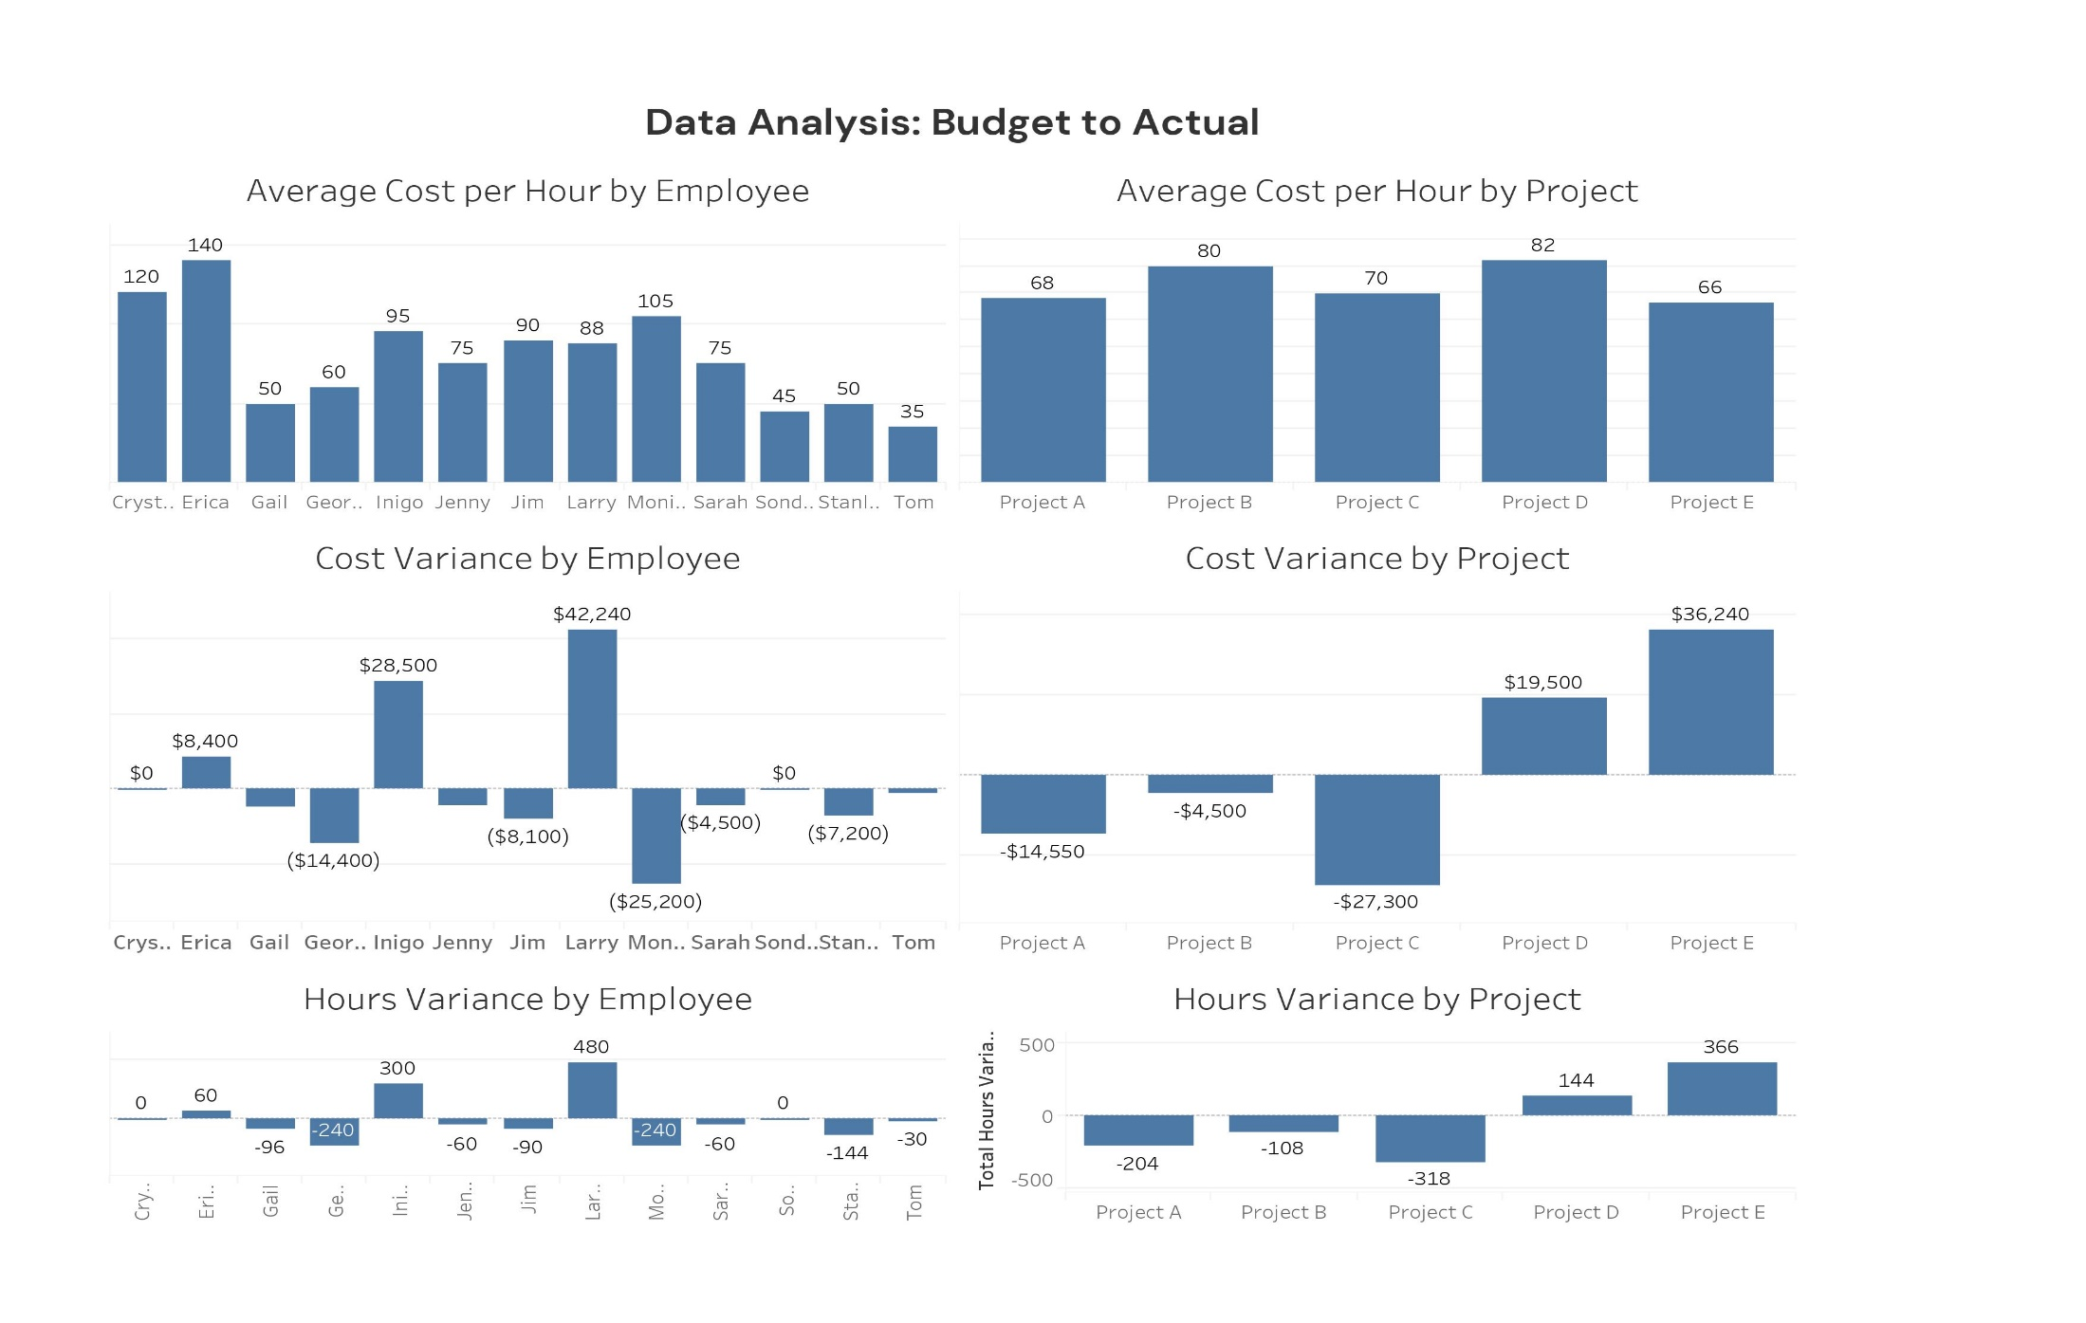
We Summarized The Data Into A Dashboard Containing All of the Key Insights

Slide 4
Summary
Budget variances are currently roughly balancing each other across the portfolio, so the portfolio itself is roughly on budget.
However, Project C is both over budget and well behind schedule, with a higher risk for failure than the rest of the portfolio. While Project C is an internal project and is thus highly important, it is necessary to investigate the sources of this delay to figure out next steps to get the project back on track.
Projects D and E have saved costs relative to their budgets and are (mostly) on schedule.
RECOMMENDATION: Program Leaders should decide on allocating resources across the portfolio of projects we have ongoing.

